Slide 1
WELCOME TO OUR PRESTENTATION
Project Title: 0 to 99 Counter

Slide 2
DIGITAL LOGIC & CIRCUITS LAB
Section : q Group : 2
Supervised By Tanbir Ibne Anowar

Slide 3
Timeline
Group Participants
Project Motives
Components & Circuit Diagram
Prospects & Limitations
Real-life Usage

Slide 4




Group Participants
Name | ID | Department
NUSHRAT JAHAN | 22-46149-1 | CSE
MD. FAHIM MURSHED | 22-46695-1 | CSE
S.M. MUJAHID SOUROV | 22-49679-3 | CSE
MD. ATIK ISHRAK SUJON | 22-46684-1 | CSE
TRIDIB SARKAR | 22-46444-1 | CSE

Slide 5
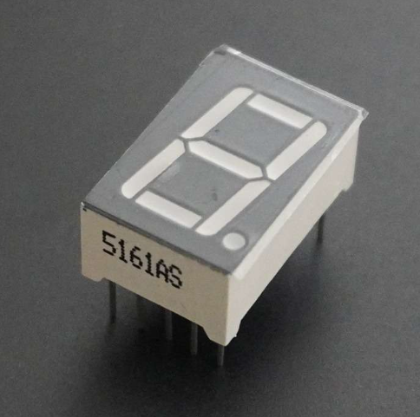
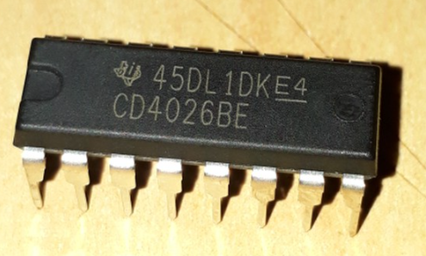
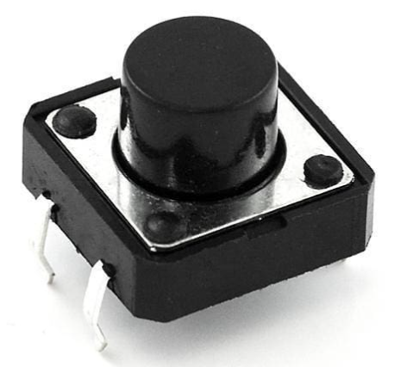
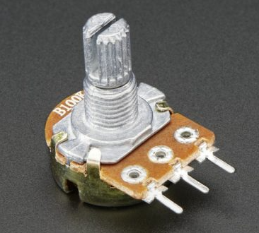
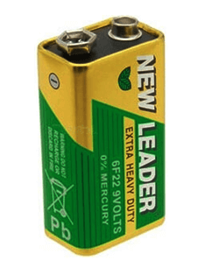
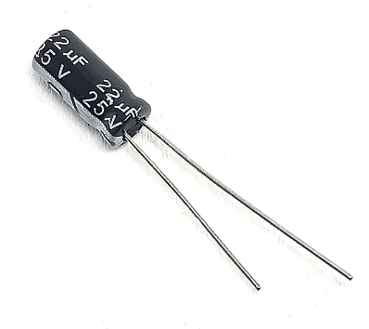
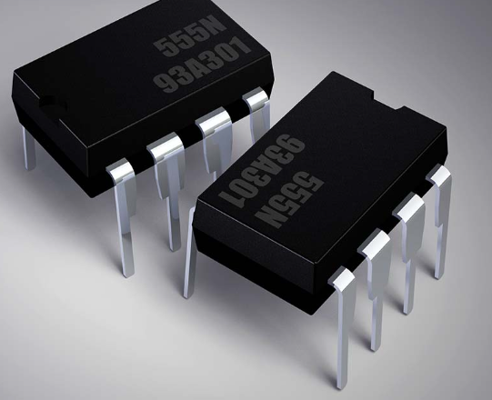
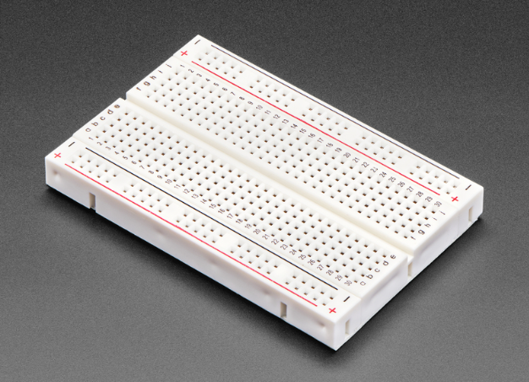
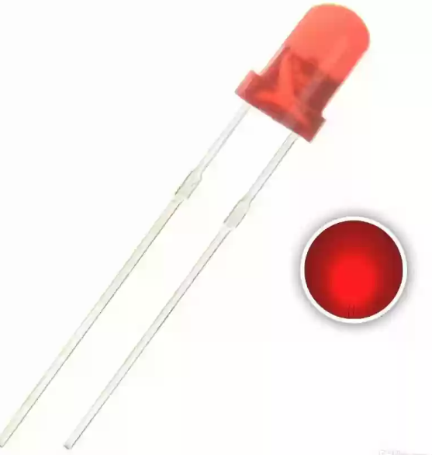
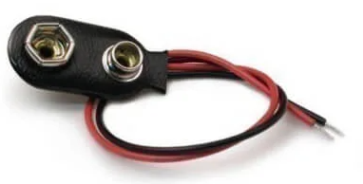

Components
7 Segment Display
IC 4026
Push Button
Potentiometer
9V Battery
22 $μF$ Capacitor
555 Timer
Breadboard
LED
Battery Connector

Slide 6
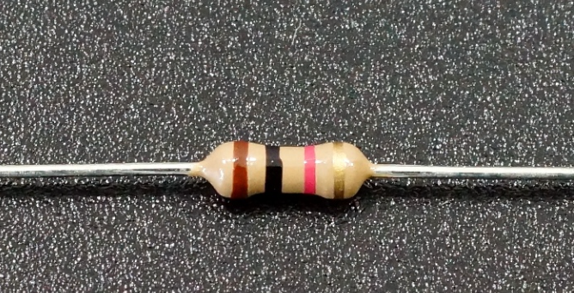
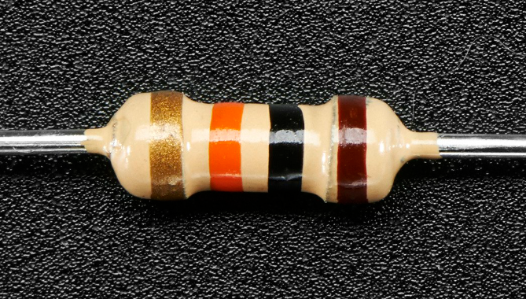
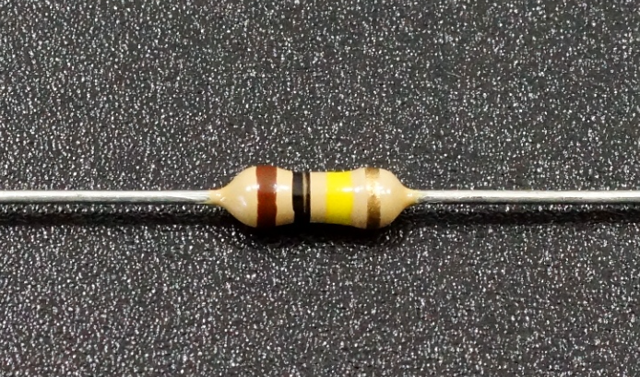
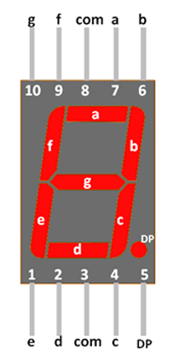
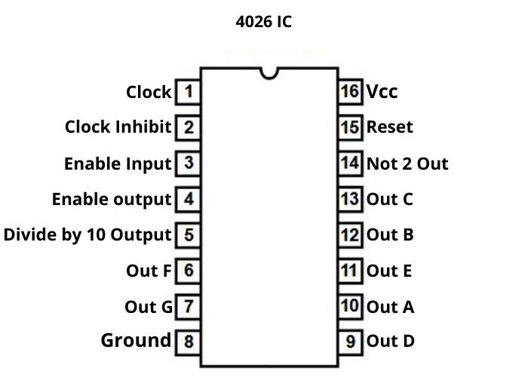

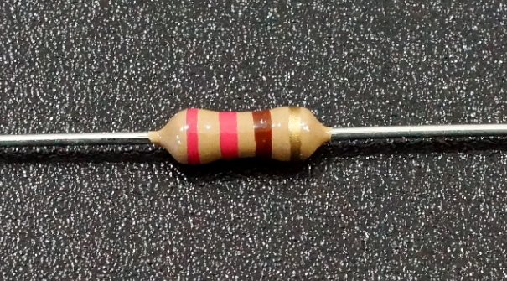
1k Ω Resistor
10k Ω Resistor
100k Ω Resistor
Seven Segment Display Configuration
220 Ω Resistor
Male Connectors
555 Timer Configuration

Slide 7
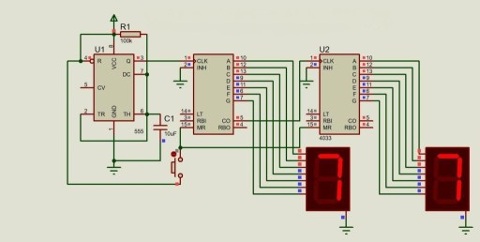
Circuit Diagram

Slide 8
Prospects
Versatile: Adaptable for various applications
Cost-Effective: Affordable with widely available components
Easy Implementation: Simple design, suitable for beginners
Educational Value: Hands-on learning in digital electronics
Integration: Can be part of larger systems for added functionality
Customizable: Flexible to meet specific project requirements
Energy-Efficient: Can be designed for low power consumption

Slide 9
Limitations
Limited Count Range: Suitable for 0 to 99 counts
Accuracy Issues: Requires careful calibration for precision
Basic Features: Lacks advanced functionalities
Size Constraints: Physical size limitations in compact spaces
Reliability Concerns: Long-term use and external factors may impact reliability
Scalability Challenges: Expanding functionality may pose challenges
Display Limitations: Visibility constraints with certain display options

Slide 10
Real-life usage
Deploy strategic networks with compelling e-business needs
PLANNING
Synergize scalable e-commerce
MARKETING
Disseminate standardized metrics
DESIGN
Coordinate e-business applications
Foster holistically superior methodologies
LAUNCH
STRATEGY

Slide 11

THANK YOU

